Slide 1

Ecotank omkar hadawale sarang shinde

Slide 2

Introduction
This project is made to raise important awareness about environmental concerns through enlightenment about carbon footprint individuals create..
It also provides platform to give citizens continent ways contribution towards planting trees.

Slide 3
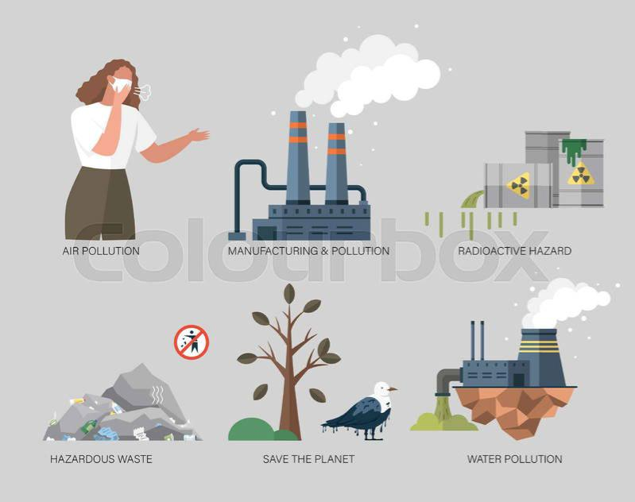
The problem
The problem of pollution is not only on physical level but it should be considered on social levels, the social awareness about pollution is must which can create big impact.
The carbon emissions causes global warming , which affects many aspects of our life .

Slide 4
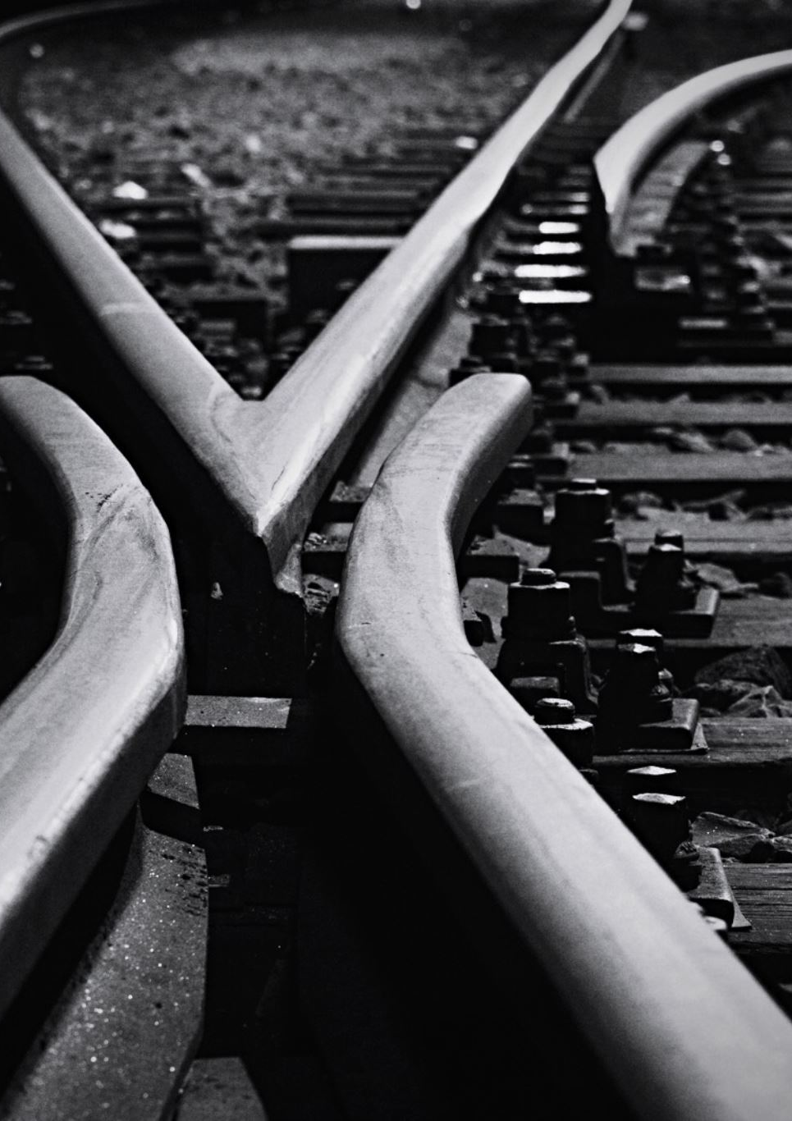
Intentions
So the intentions of this project is to raise awareness but with scientific justification so the citizens of country can comprehend the individual impact of their carbon footprint on environment.
This will also be way so social awareness as the carbon footprint of individual can be seen by other so , it can give status and purpose to reduce carbon emissions and can act as societal pressure.

Slide 5

Invention
This project will make people be able to calculate their carbon footprints so they can self reflect and try to minimize their carbon footprint.
It also allows users to take initiatives towards tree plantation by simple interface to contribute environment by planting trees .

Slide 6
Methodology
We use world press containt management system to create this website.
Also used HTML5 (to create heading sections menu’s,carbon footprint calculator and tress plantation interface.)
CSS 3 (Cascadian style sheet) to design and style layout.
Php (hypertext preprocessor)
XAMPP and Apache servers.

Slide 7

Thanks you

